Slide 1










DEPARTMENT OF ELECTRONICS & TELECOMMUNICATION ENGINEERING
PRESENTS
2.0
A 24-HOUR HARDWARE HACKATHON
POWERED BY
ROUND 2 Submission

Slide 2

Introduction
2.0
A 24-HOUR HARDWARE HACKATHON
[Team Name]:MATRIX
[Member Names]:Krishna Mallawat, Atharva Dalvi, Harsh Tiwari, Kaushik TVSND
[College Name]:K.J Somaiya College of Engineering

Slide 3

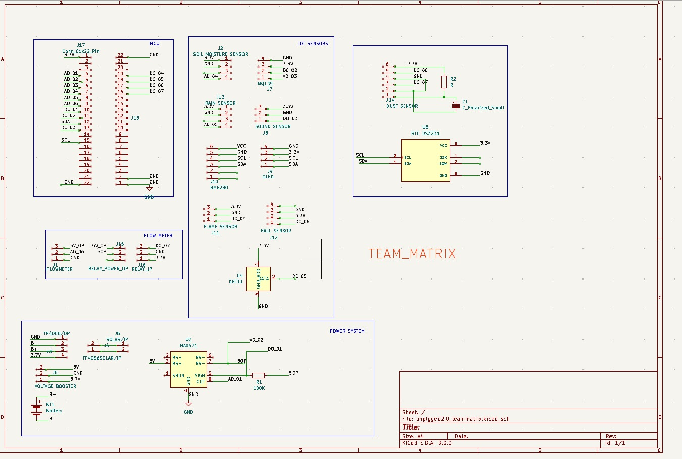
Schematic Photo
2.0
A 24-HOUR HARDWARE HACKATHON
[Team Name]: MATRIX

Slide 4
Schematic Explanation
2.0
A 24-HOUR HARDWARE HACKATHON
Project Demonstration :
To simplify the testing and debugging process, header pins have been incorporated for easy connections.
This modular approach allows flexibility in connecting and replacing components without requiring soldering.
ESP32S3 as the Core MCU:
The ESP32-S3 development module is used as the main processing unit.
It provides WiFi and Bluetooth connectivity, making it ideal for IoT-based applications.
Multiple GPIO pins are utilized for interfacing with various sensors and actuators.
Integration of IoT Sensors:
The system incorporates a range of environmental and monitoring sensors, including:
MQ-135 Gas Sensor - Detects air quality and harmful gases.
BME280 Environmental Sensor - Measures temperature, humidity, and pressure.
DHT11 Sensor - Provides temperature and humidity readings.
Hall Effect Sensor - Used for current sensing or motion detection.
Soil Moisture Sensor - Useful for agriculture and smart irrigation.
Rain & Dust Sensors - Detect environmental conditions.
OLED Display - Displays real-time sensor data.
RTC (DS3231) Module - Provides accurate timekeeping for logging data.
Power Management System with Solar Integration:
The system supports a solar-powered battery charging unit using the TP4056 module.
Voltage booster ensures stable power supply for sensors and ESP32S3.
Scalability and Modularity:
The design follows a modular approach, allowing future enhancements with minimal redesign.
Multiple sensors and modules can be added or replaced easily.
[Team Name]: MATRIX

Slide 5
PCB Layout
2.0
A 24-HOUR HARDWARE HACKATHON
[Team Name]: MATRIX

Slide 6
PCB Description
2.0
A 24-HOUR HARDWARE HACKATHON
GIS as shown
[Team Name]: MATRIX

Slide 7
2.0
A 24-HOUR HARDWARE HACKATHON
THANK YOU
[Team Name]:MATRIX

